Slide 1


Preventing Child Abuse and Supporting Families
in West Virginia
Prioritizing Prevention in West Virginia 2020, Virtual Summit
Jim McKay, State Coordinator, Prevent Child Abuse West Virginia
Sean O’Leary, Senior Policy Analyst, West Virginia Center on Budget and Policy

Slide 2


What Happens in Early Childhood Can Matter for a Lifetime

Slide 3
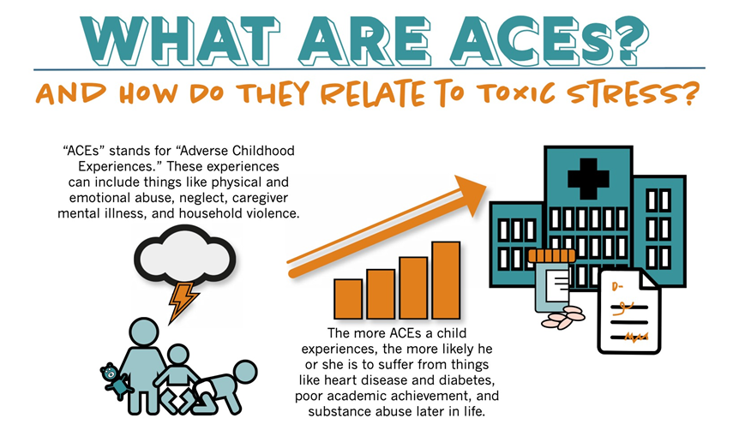
Adverse Childhood Experiences - ACES

Slide 4
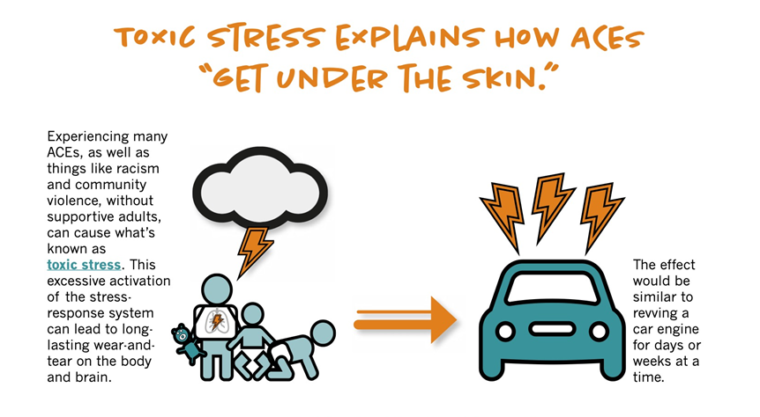
Adverse Childhood Experiences - ACES

Slide 5

Adverse Childhood Experiences - ACES

Slide 6
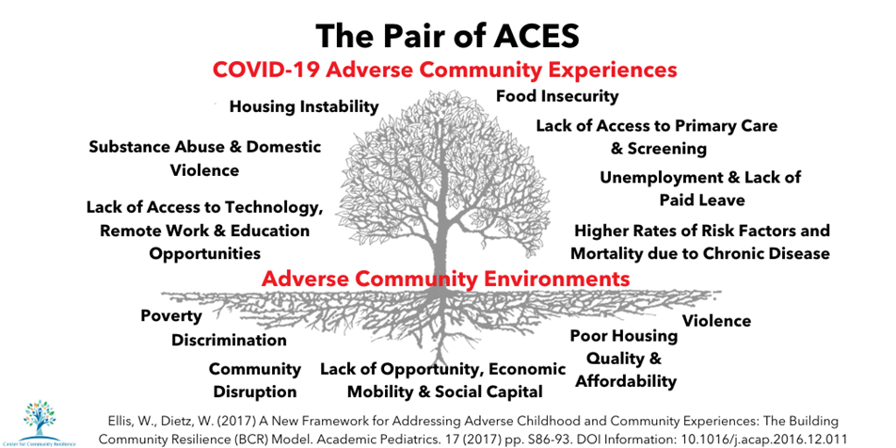
Adverse Childhood Experiences - ACES

Slide 7
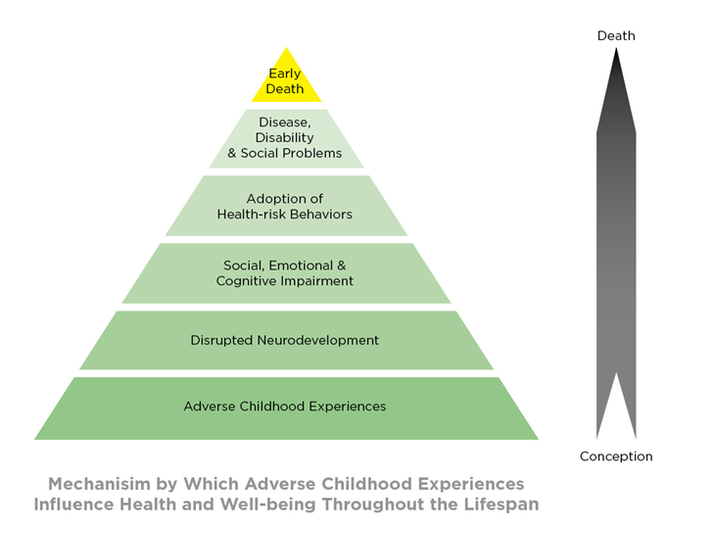
Adverse Childhood Experiences - ACES

Slide 8
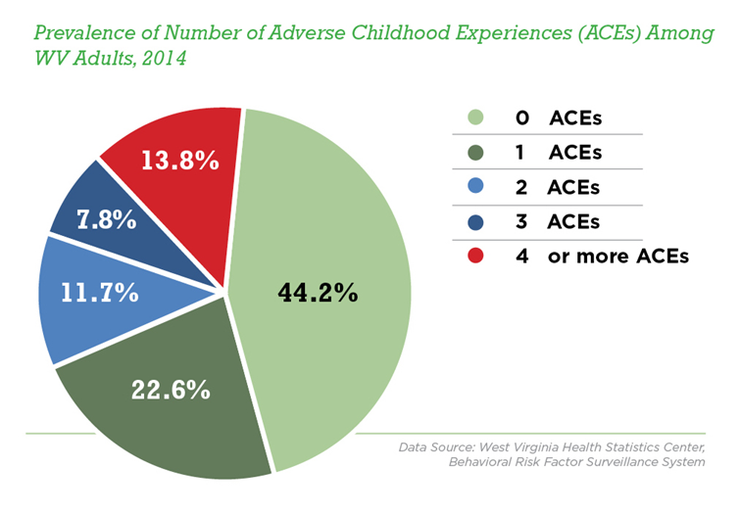
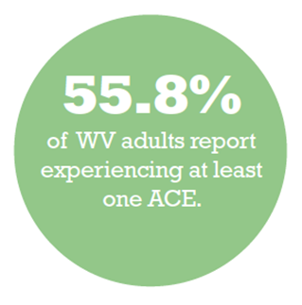
Adverse Childhood Experiences - ACES

Slide 9
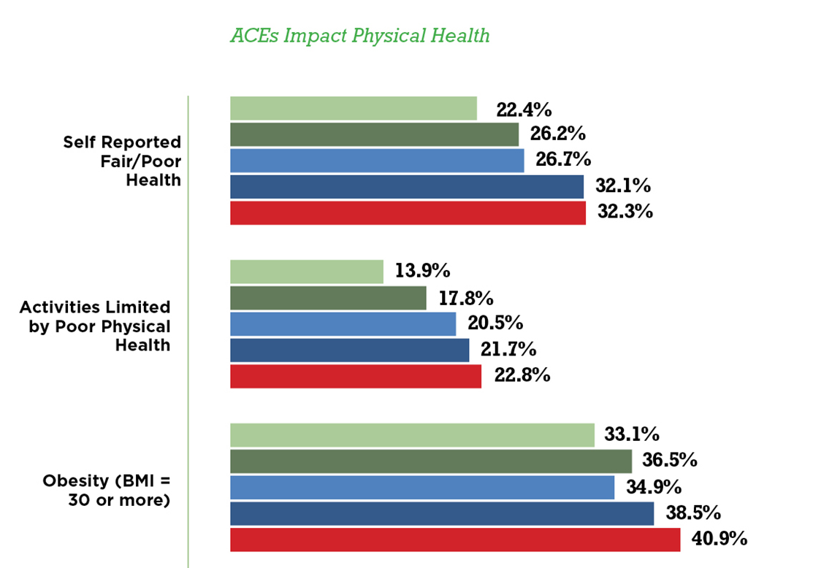
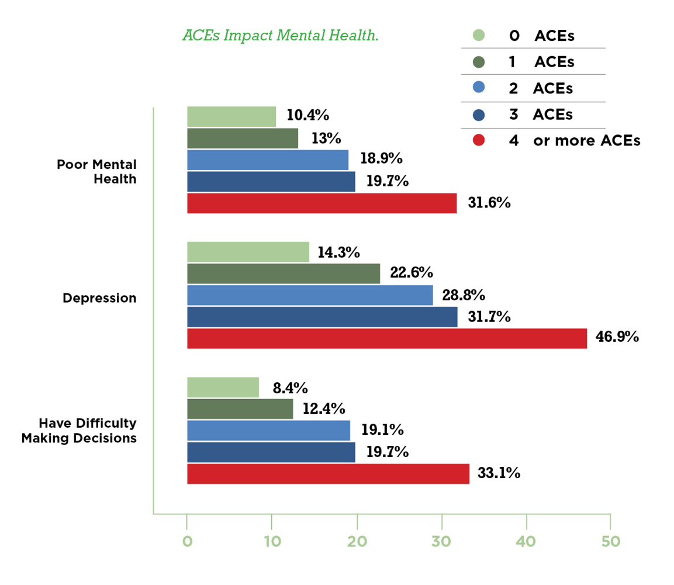
Adverse Childhood Experiences - ACES

Slide 10
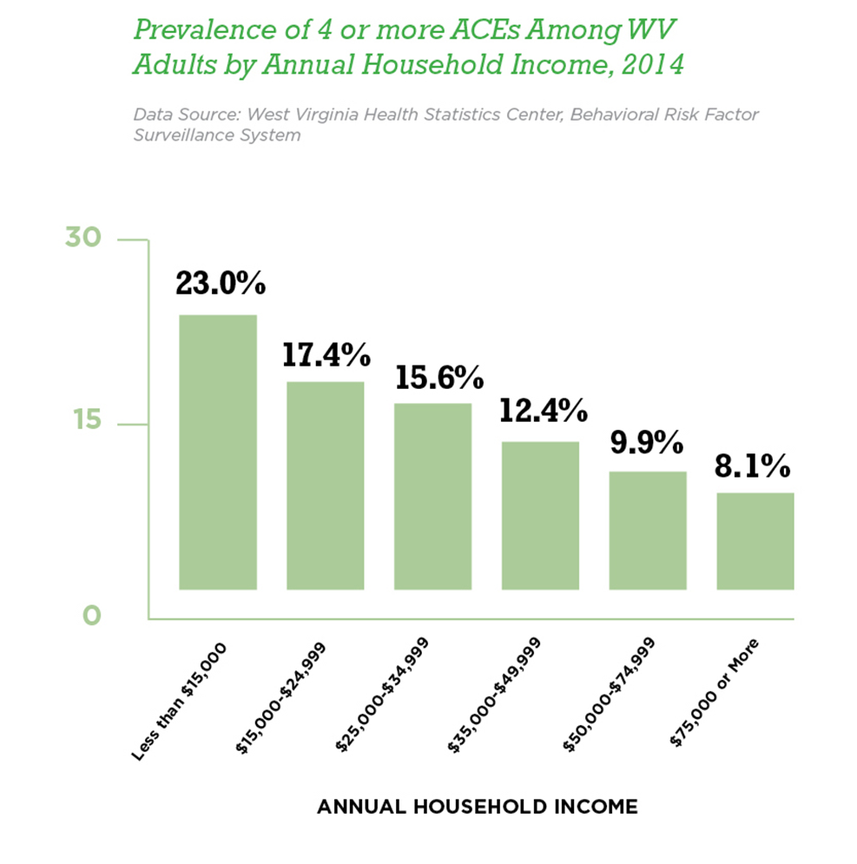
Adverse Childhood Experiences - ACES

Slide 11
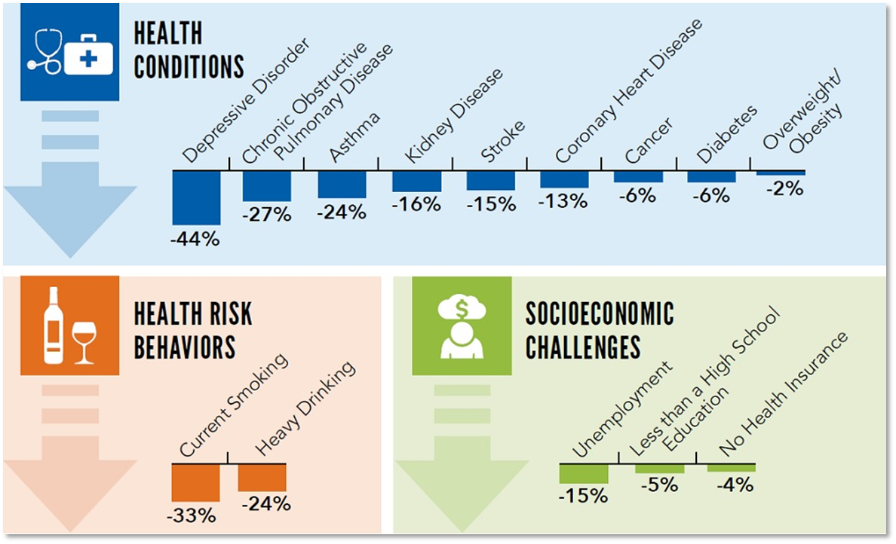
Potential Reduction of Negative Outcomes from Preventing ACES

Slide 12
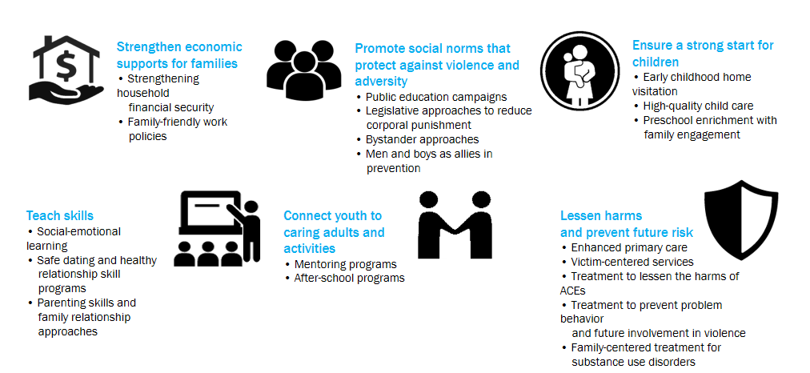
Strategies for Preventing ACES

Slide 13
Policies to Strengthen West Virginia Families
In the past 15 years, West Virginia has drastically cut corporate taxes while pursuing a path of budget austerity, resulting in less investment in our communities and less opportunity for the average West Virginian.
While the state’s economy has grown over the last decade, that growth has not trickled down to working families or helped lift people or places out of poverty.
The strength and prosperity of working families should be a priority in West Virginia. Policy choices can make it easier for a parent to support their family, improving the health and livelihood of their children, leading to better outcomes for generations to come.

Slide 14
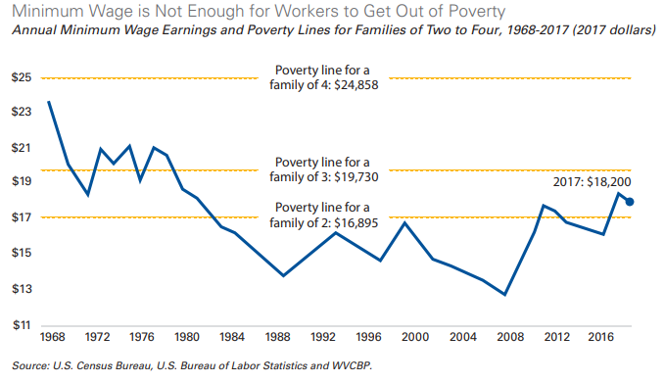
Raising the Hourly Minimum Wage to $15 by 2025

Slide 15
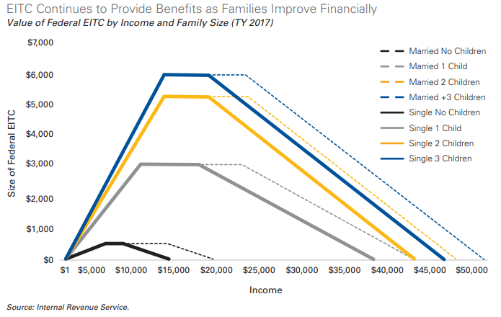
Creating a West Virginia Earned Income Tax Credit

Slide 16
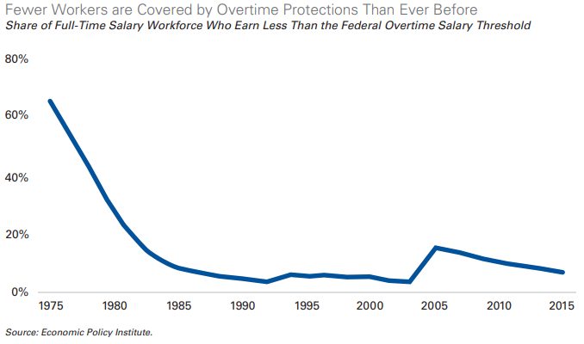
Expanding Overtime Protection

Slide 17
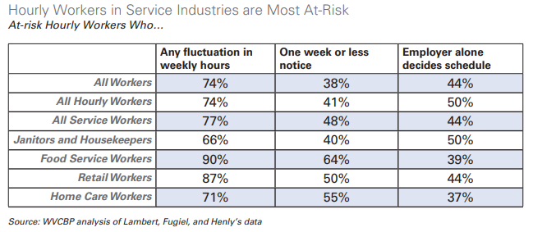
Establishing a Fair Workweek

Slide 18
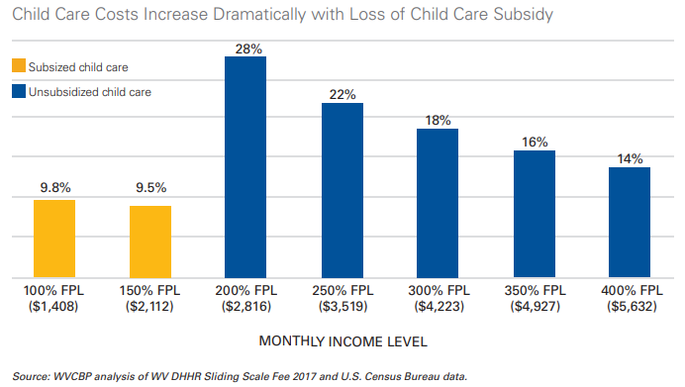
Enhancing Child Care Assistance

Slide 19
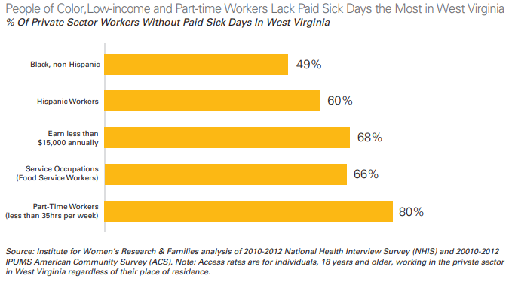
Paid Sick Days

Slide 20
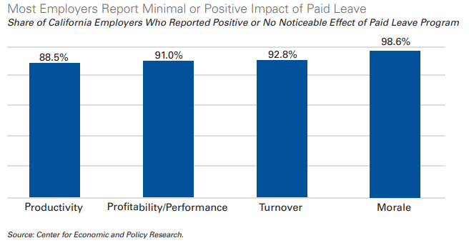
Paid Family and Medical Leave

Slide 21
For More Information
Jim McKay
Prevent Child Abuse WV
http://www.preventchildabusewv.org
Jim@TEAMWV.org
Sean O’Leary
West Virginia Center on Budget and Policy
http://www.wvpolicy.org
soleary@wvpolicy.org

